Slide 1


Improving Schema Matching with Linked Data
Ahmad Assaf†, Eldad Louw†, Aline Senart†, Corentin Follenfant†,
Raphaël Troncy‡ and David Trastour†
†SAP Research, SAP Research France SAS
‡EURECOM, Sophia Antipolis - France
1st International Workshop on Open Data (WOD), Nantes - France
May 25, 2012
Public

Slide 2
Agenda
Problem definition
Related work
Our Proposal
Implementation
Experiments
Conclusion and future work
References

Slide 3






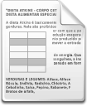




Problem Definition Linking External Data
Decision Making Process
Enterprise Data
Social Media Feeds
Business Intelligence Analysis
Sensor Data
Governmental Data
ERP - -
PRM
CRM
Distributed sources with heterogeneous data formats and terminologies
Complex data models
Different storage models
Noisiness (duplications, inconsistencies)
→ Need to find mappings between these internal and external complex data structures (schema matching)
Notes:
Companies have traditionally performed business analysis based on transactional data stored in legacy relational databases. The enterprise data available for decision makers was typically relationship management or enterprise resource planning data [2]. However social media feeds, weblogs, sensor data, or data published by governments or international organizations are nowadays becoming increasingly available [3].
Model/representation heterogeneity → differnces in model (database, ontology) or their representation (relational, RDF . )

Slide 4
Related Work Schema Matching on Tabular Data
Schema Matching is the process of identifying that two objects are semantically related
A multitude of Schema Matching systems exist, generally they consider [1]:
Syntactic similarity
Structural similarity
Instance similarity
Some work has been done to enable labeling through Web extraction [2,3,4]
More recently, work has been done on exploiting Linked Data repositories but with different objectives such as enriching and exporting tabular data [5,6,7]
Notes:
Active research area in Data integration
Plays a central role in many applications that require interoperability between heterogeneous data sources
Compare Columns Headers, String matching, different langauges .. Etc, the importance of having a column label → problem: no labels, dictioanries, wordnet
Compare Primitive data types (Date, String, Integer, Double … etc.) and Handling Hierarchy, Structural --> for example keys in tables and hierarchy in XML like files
where the same real world entity is represented using different terms or vice-versa
Problem: Targeted at constructing semantic search queries not at improving schema matching
Problem: Acronyms and languages are not well handled
Problem: Results independent from the existing column name and sampling are not always good representation of the population.
Tags to help indexing
Enrich table and republish into linked data
→ Not used for schema matching, abbreviations, languages .. etc

Slide 5
Our Proposal
Goal: Allow business users to semi-automatically combine potentially noisy data residing in heterogeneous silos
Proposal
Implementation
Provide a novel framework enabling schema matching of internal and external sources
Develop several matching algorithms to increase accuracy
Leverage Linked Data to enrich the cells
Compare schemas on several bases:
Column global type and name
Cells` rich types retrieved from Linked Data
Google Refine [8]: A tool designed to process, clean and enrich large amounts of data with existing knowledge bases
Auto Mapping Core [9]: A tool designed by SAP Research, enabling the developer to combine several matching algorithms
Freebase [10]: An open repository of structured data
Notes:
Google Refine targets one data set at a time (no possibility for data sets mash-up)
Google Refine already supports reconciliation with Freebase but requires confirmation from the user.

Slide 6
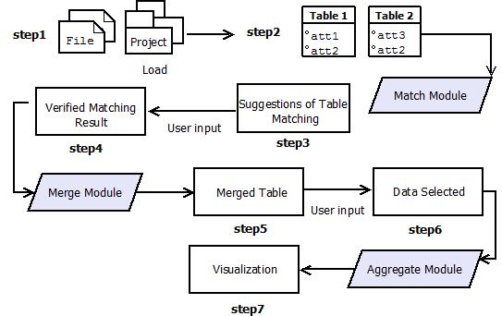
Our Proposal

Slide 7
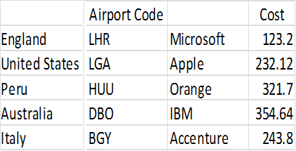
Implementation
Step 1: Choose two different schemas to match
Different languages (header name and cell values)
Abbreviations
Codes (IATA, NASDAQ)
Empty column headers
Notes:
Workflow

Slide 8
Our Proposal

Slide 9
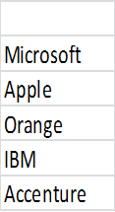
Implementation
Step 2: Map each cell with a set of “Rich Types”
The Result for Microsoft is: {Software=86.118179, Website=42.362911, Video Game Platform=137.838684, Organization=232.759842, Programming Language=67.981903, File Format=69.533485}
The Result for Apple is: {Physicist=54.597713, Organism Classification=153.355011, Video Game Platform=91.149803, Computer=64.025963, Organization=210.666855, Record label=52.227253}
The Result for Orange is: {Monarch=77.261147, US County=83.572784, Organism Classification=174.263657, Order of Chivalry=55.610447, Organization=157.174515, Color=125.234734}
The Result for IBM is: {Software=32.009403, Operating System=51.03334, Video Game Platform=100.333168, Computer=47.497246, Organization=207.017471, Computing Platform=31.616125}
The Result for Accenture is: {Book=7.331758, Building=11.667136, Organization=77.445473}
Results retrieved from Freebase have a defined confidence score
The confidence score for each type is query independent

Slide 10
Implementation
Step 3: Map each column with an aggregated set of “Rich Types”
Column has the following types:
Type : Book has been found 1 time(s), with total confidence = 7.331758
Type : Building has been found 1 time(s), with total confidence = 11.667136
Type : Color has been found 1 time(s), with total confidence = 125.234734
Type : Computer has been found 2 time(s), with total confidence = 111.52320900000001
Type : Computing Platform has been found 1 time(s), with total confidence = 31.616125
Type : File Format has been found 1 time(s), with total confidence = 69.533485
Type : Monarch has been found 1 time(s), with total confidence = 77.261147
Type : Operating System has been found 1 time(s), with total confidence = 51.03334
Type : Order of Chivalry has been found 1 time(s), with total confidence = 55.610447
Type : Organism Classification has been found 2 time(s), with total confidence = 327.61866796
Type : Organization has been found 5 time(s), with total confidence = 885.064156
Type : Physicist has been found 1 time(s), with total confidence = 54.597713
Type : Programming Language has been found 1 time(s), with total confidence = 67.981903
Type : Record label has been found 1 time(s), with total confidence = 52.227253
Type : Software has been found 2 time(s), with total confidence = 118.12758199999999
Type : US County has been found 1 time(s), with total confidence = 83.572784
Type : Video Game Platform has been found 3 time(s), with total confidence = 329.321655
Type : Website has been found 1 time(s), with total confidence = 42.362911
Columns now are represented by the associative set of “Rich Types”

Slide 11
Implementation
Step 4: Label and Type (unnamed and un-typed columns)
Wilson score interval for a Bernoulli parameter [11] used to determine normalized score for each type in the set by balancing the proportion of high scores with the lower ones
Step 5: Calculate a similarity score between two columns
We have implemented the following algorithms:
Vector algebra (Cosine Similarity) [12]
Statistical algorithms:
Pearson Product-Moment Correlation Coefficient (PPMCC) [13]
Spearman’s Rank Correlation Coefficient [14]

Slide 12
Experiments
Notes:
Workflow

Slide 13
Experiments Results
AMC by default runs a set of String matching algorithms between columns` headers
Extra plugins (matchers) can be configured and added
The results of different matchers are combined using different methods, for our experiments the default “average method” is used
The results of AMC default matching algorithms:

Slide 14
Experiments Results
AMC’s default set + Cosine Similarity
AMC’s default set + Cosine Similarity + PPMCC method
AMC’s default set + Cosine Similarity + PPMCC method + Spearman’s

Slide 15
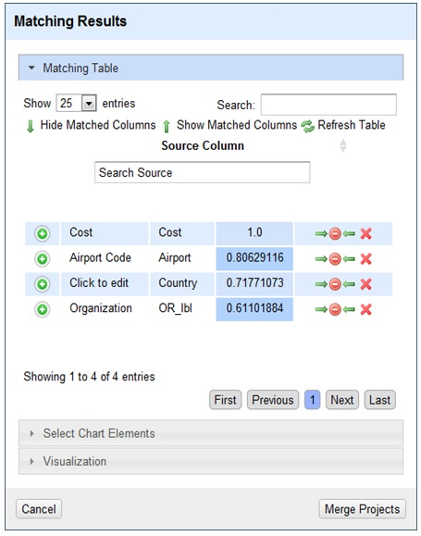

Slide 16
Our Proposal

Slide 17
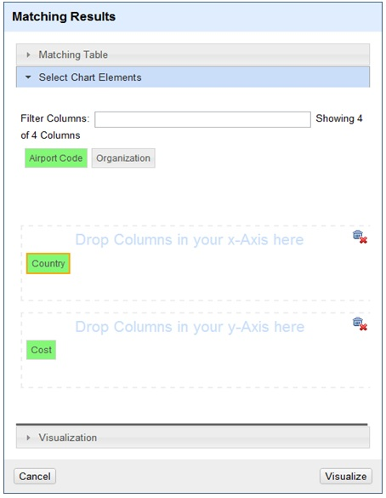

Slide 18
Our Proposal

Slide 19
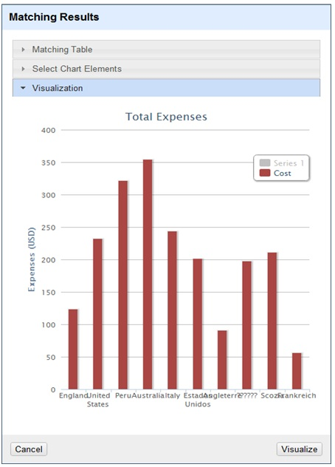

Slide 20
Conclusion and Future Work
The number of matches discovered is increased when Linked Data is used in most data sets
Schema matching can be improved even if they contain unnamed or un-typed columns
Data reconciliation can be performed regardless of data source languages
→ More valuable and higher quality data is available for more informed decisions
Future Work
Evaluate the framework on larger data sets
Integrating additional Linked Open Data sources of semantic types such as DBpedia or YAGO
Evaluate our matching results against instance-based ontology alignment benchmarks (and bring datasets that highlight noisy tabular data)

Slide 21
Thank You!
Contact information:
Ahmad Assaf
@ahmadaassaf
SAP Research, France
Ahmad.assaf@sap.com
+33 695 436 614

Slide 22
References
[1] Eric peukert, Julian Eberius, Erhard Rahm, “A Self-Configuring Schema Matching System”, IEEE International Conference on Data Engineering (ICDE) 2012.
[2] Davy de Castro Reis, Paulo B. Golgher, Altigran S. da Silva, and Alberto H. F. Laender, "Automatic Web News Extraction Using Tree Edit Distance," in 13th International Conference on World Wide Web, 2004.
[3] Jiying Wang and Fred Lochovsky, "Data Extraction and Label Assignment for Web Databases," in 12th International Conference on World Wide Web, 2003.
[4] Altigran S. da Silva, Denilson Barbosa, M. B. Joao Cavalcanti, and A. S. Marco Sevalho, "Labeling Data Extracted from the Web," in International Conference on the Move to Meaningful Internet Systems, 2007.
[5] Girija Limaye, Sunita Sarawagi, and Soumen Chakrabarti, "Annotating and Searching Web Tables Using Entities, Types and Relationships," Proceedings of the VLDB Endowment, vol. III, no. 1, pp. 1338-1347, September 2010.
[6] Tim Finin, Zareen Syed, James Mayfield, Paul McNamee, and Christine Piatko, "Using Wikitology for Cross-Document Entity Coreference Resolution," in AAAI Spring Symposium on Learning by Reading and Learning to Read, 2009.
[7] Oktie Hassanzadeh et al., "Helix: Online Enterprise Data Analytics," in 20th International World Wide Web Conference - Demo Track, 2011.
[8] Google Code. Google Refine. [Online]. http://code.google.com/p/google-refine/
[9] Eric Peukert, Julian Eberius, and Erhard Rahm, "AMC - A Framework for Modelling and Comparing Matching Systems as Matching Processes," in International Conference on Data Engineering - Demo Track, 2011.
[10] Metaweb Technologies. Freebase. [Online]. http://www.freebase.com/
[11] Brown, Lawrence D.; Cai, T. Tony; DasGupta, Anirban (2001). "Interval Estimation for a Binomial Proportion". Statistical Science 16 (2): 101–133
[12] P.-N. Tan, M. Steinbach & V. Kumar, "Introduction to Data Mining", , Addison-Wesley (2005)
[13] Charles J. Kowalski, "On the Effects of Non-Normality on the Distribution of the Sample Product-Moment Correlation Coefficient," Journal of the Royal Statistical Society, vol. 21, no. 1, pp. 1-12, 1972.
[14] Sarah Boslaugh and Paul Andrew Watters, Statistics in a Nutshell.: O'Reilly Media, 2008

